Slide 1
Concerns About the Potential for Induced Seismicity Associated with the Mississippian Play: Perceived or Real?
Austin Holland and Dr. G. Randy Keller
Oklahoma Geological Survey
University of Oklahoma

Slide 2
Outline
Induced Seismicity Background
Induced Seismicity Regional Context
Potential for Induced Seismicity in the Mississippian Play
Possibilities for Risk Mitigation
Best Practices

Slide 3
Earthquake Triggering
Natural Causes
Anthropogenic
Dynamically by the passage of seismic waves
typically from very large earthquakes distances > 1000 miles
Statically by local stress changes from previous earthquakes
Small amounts of stress changes have been shown to trigger earthquakes
as little as 2-7 psi
Natural fluid movement
May be the cause of many aftershocks of large earthquakes
Hydrologic loads
Reservoir Impoundment
Mining and Oil Production (Mass Removal)
Fluid Injection
Geothermal Production & Thermal Contraction

Slide 4
Induced Seismicity from Fluid Injection
Most of the Earth’s upper crust is near failure
Increased pore pressure from fluid injection effectively reduces friction on fault
Or in Mohr-Coulomb space moves the circle towards failure
τ
σ_{n}
τ
Failure
τ_{o}
σ_{n}
Add Pore Pressure
p
Notes:
Size of the Mohr-Coulomb circles are the deviatoric stress sigma1-sigma3
Of course pressure doesn’t instantaneously increase as shown here, but how does it propogate within the Earth

Slide 5
Pressure Diffuses Within the Earth
Pressure increase is not due to actual fluid flow
Can be much more rapid
Because water is fairly incompressible it is similar to an elastic response although slower
Diffusivity is
T = transmissivity
S = storativity
Pressure increases over time
Talwani et al. (2007) J. Geophys Res.
Notes:
Top figure shows the time progression of pressure from an injection well injecting at a constant pressure
Bottom figure shows the range of diffusivity observed in most cases of induced seismicity

Slide 6
Risk from Induced Earthquakes
Hydraulic Fracturing (Lower Risk)
Magnitudes less generally less than 0
Observed maximum magnitude (M_{max}) 3.1-3.4
Injection duration may be weeks
Water Disposal (Higher Risk)
Observed M_{max} 5.3-5.7
Damage from some events
Injection duration may be decades
Notes:
Generally seismol

Slide 7
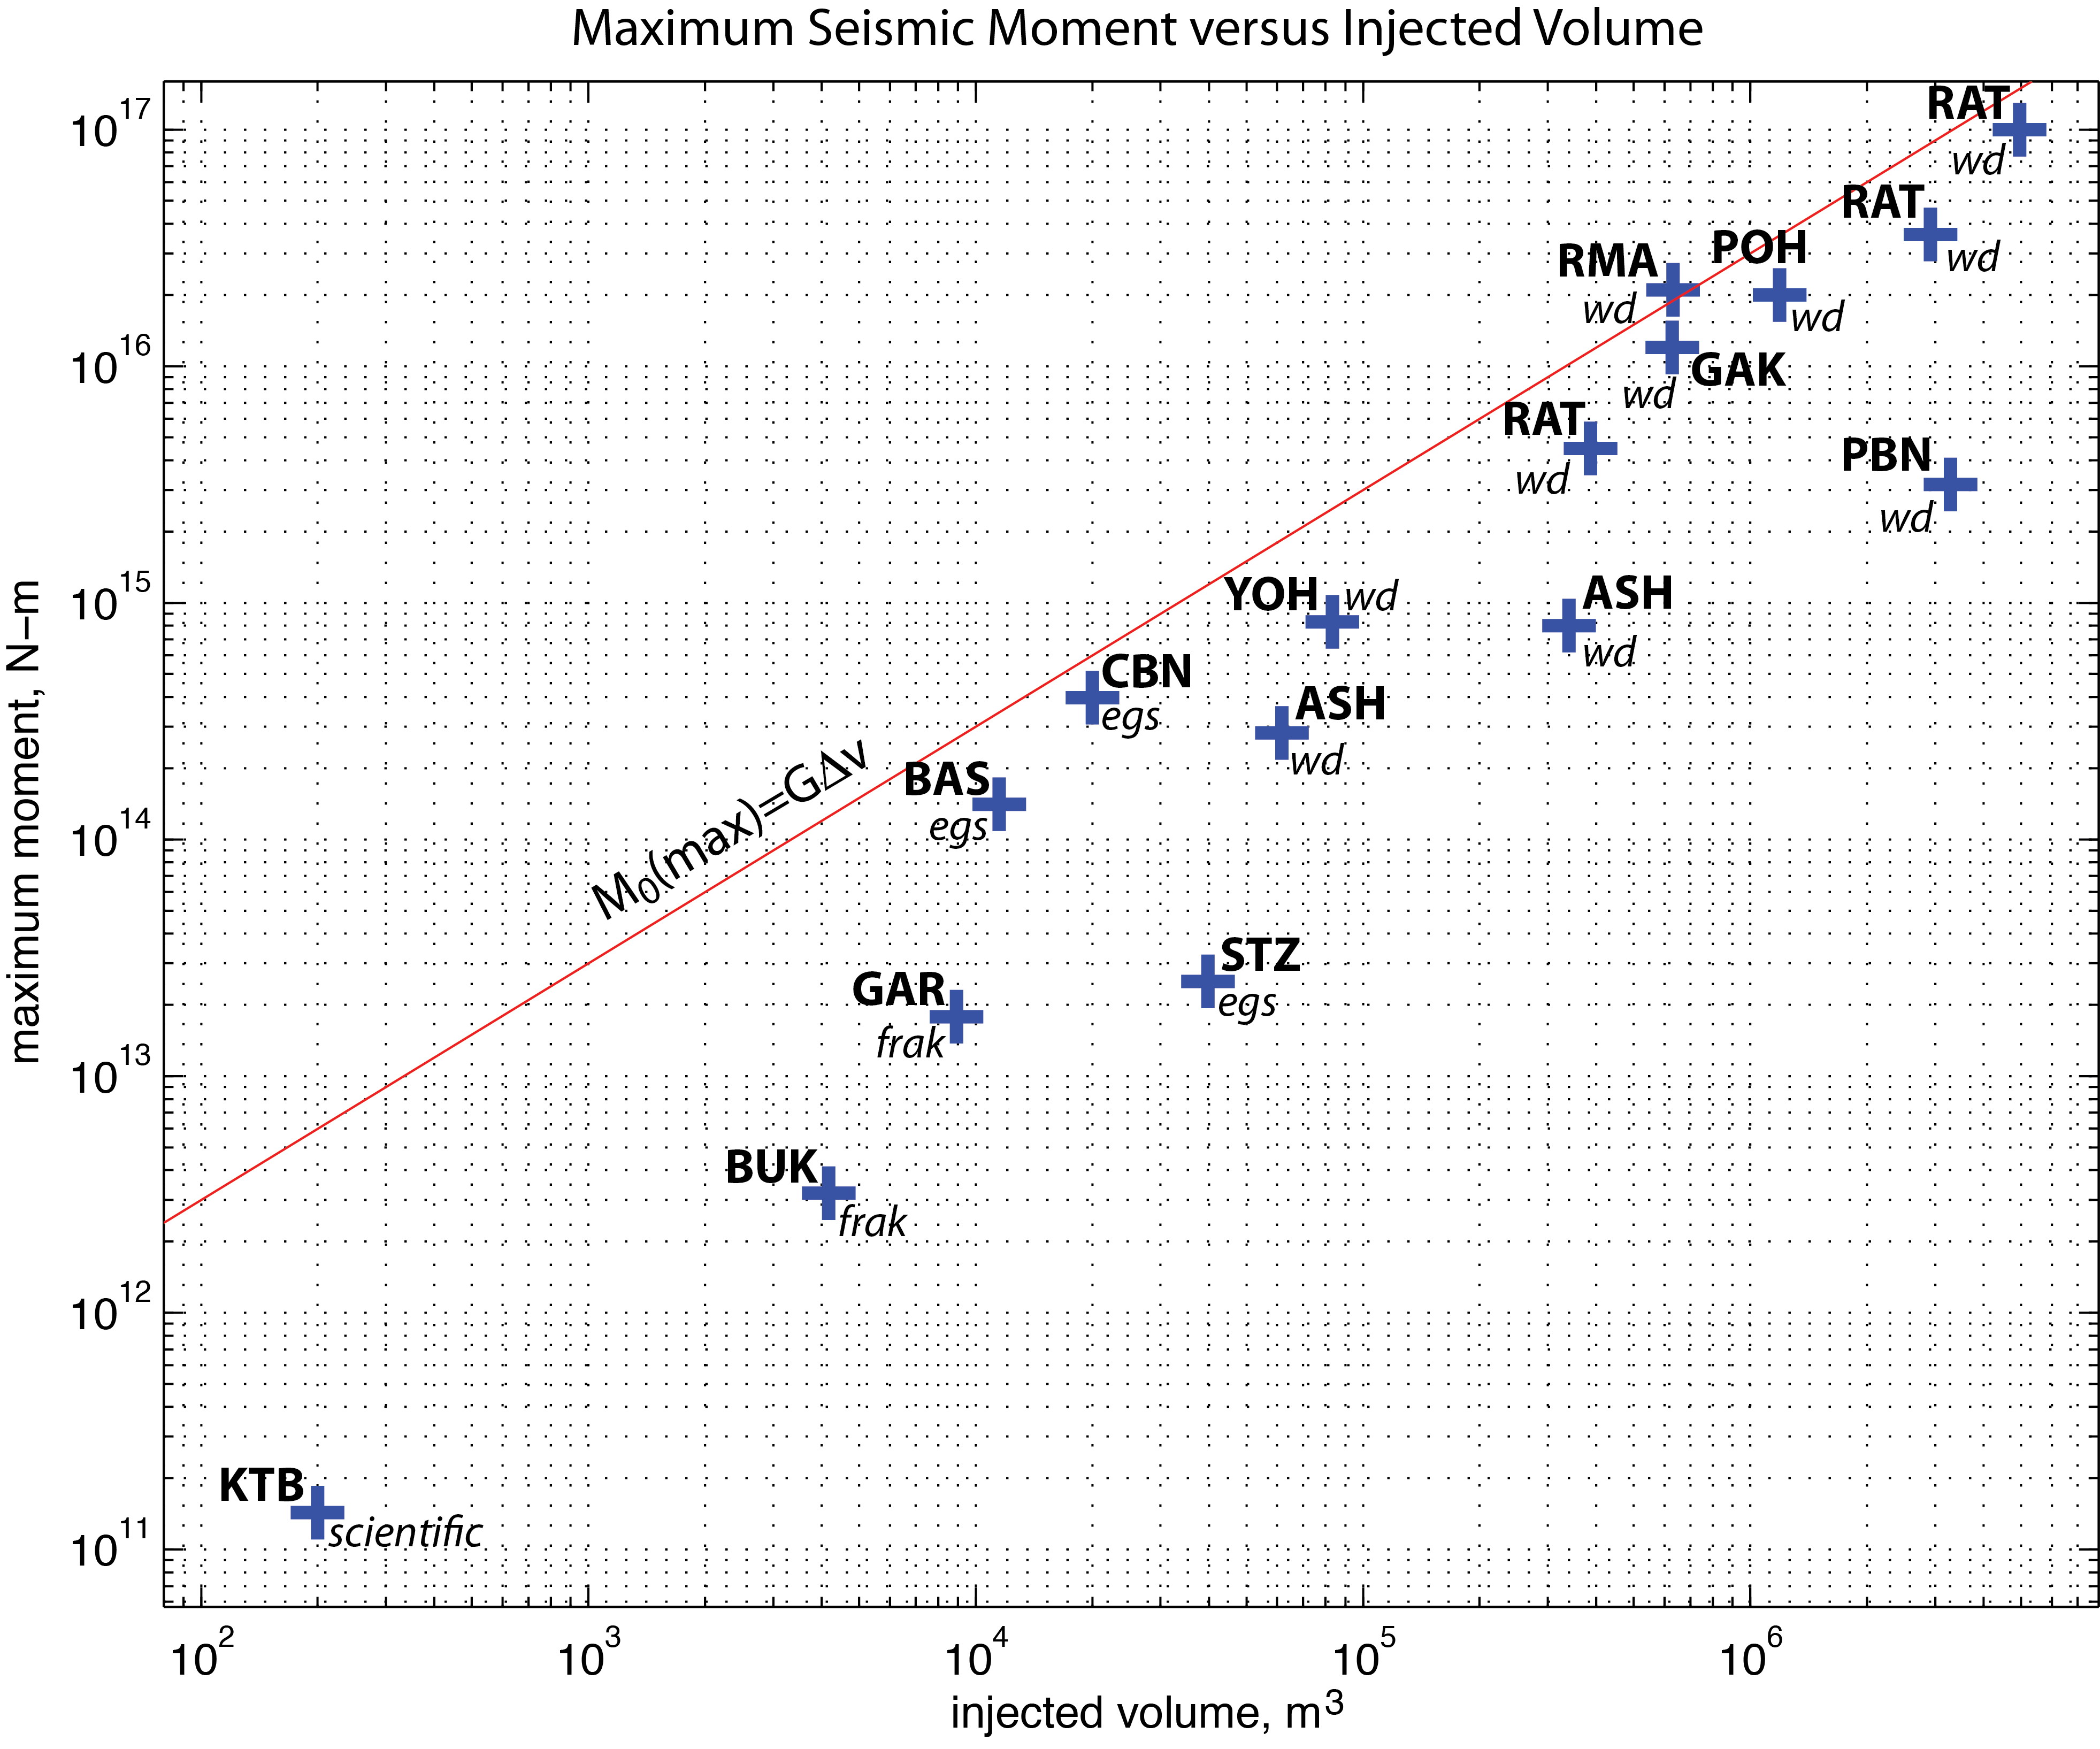
RAT=Raton Basin
RMA=Rocky Mtn Arsenal.
YOH=Youngstown OH
PBN=Paradox Valley CO
GAK=Guy AK
BAS=Basel Switzerland
GAR=Garvin County OK
BUK=Bowland Shale UK
KTB=eastern Bavaria Germany
Magnitude
Injection Duration
Courtesy of Art McGarr (USGS)
Notes:
This plot of maximum seismic moment, the standard measure of earthquake deformation, as a function of total injected volume. Note that all of the large magnitude events are associated with wastewater disposal. The M3.4 earthquake in Basel Switzerland, although not very large, nonetheless had serious consequences, including project termination and many insurance claims. The maximum magnitude earthquakes in the Raton basin increased with total injection volume, M4.5 in 2001, M5 in 2005 and most recently, M5.3 in 2011. These data represent only the exceptionally large induced earthquakes. Indeed, the vast majority of injection wells do not produce earthquakes large enough to be felt by the public. For each point, wd=wastewater disposal, egs=enhanced geothermal system, and frak=hydraulic fracturing. RAT=Raton Basin, RMA=Rocky Mtn Arsenal. POH=Painesville OH, YOH=Youngstown OH, ASH=Ashtabula OH, PBN=Paradox Valley CO, GAK=Guy AK, CBN=Cooper Basin Australia, BAS=Basel Switzerland, STZ=Soutz sous Forets France, GAR=Garvin County OK, BUK=Bowland Shale UK, KTB=eastern Bavaria Germany.

Slide 8
Injection Induced Seismicity
Best Documented Cases
General Observations
Rangely, CO – Raleigh et al. (1976) Science
Paradox Valley, CO, Ake et al. (2005) Bull. Seismol. Soc. Amer.
KTB, Germany, Baisch et al. (2002) Bull. Seismol. Soc. Amer.
Basel, Switzerland, Deichmann & Giardini (2009) Seismol. Res. Letters
Rocky Mountain Arsenal, CO, Hsieh & Bredehoeft (1981) J. Geophys. Res.
Earthquakes occur first near the well and migrate away from the well with time
Earthquakes have a clear temporal correlation to injection
Time and spatial distribution of earthquakes can generally be related to diffusion of pore pressure
Earthquakes can occur over long distances >20 km
Modifying injection parameters alters earthquake production

Slide 9
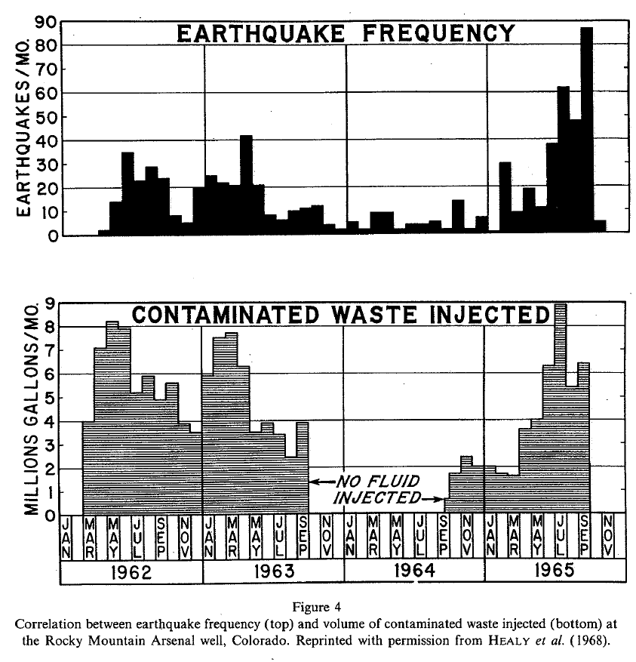
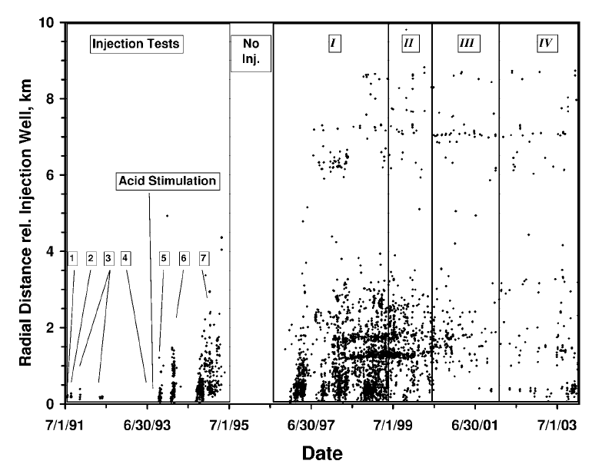
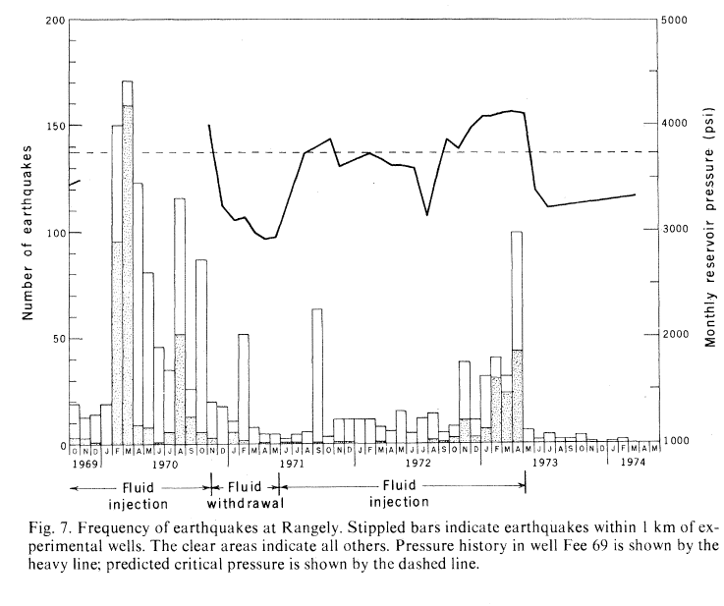
Paradox Valley, Ake et al. (2005)
RMA, Healy et al. (1968)
Rangely, Raleigh et al. (1976)

Slide 11
Induced Seismicity from Water Disposal
Possible Cases from Oklahoma
M5.6 Prague Earthquake, 3 disposal wells within ~1 mile
Jones Earthquake Swarm, ~1800 earthquakes, M_{max}=4.0, large volume wells within 8-12 miles
Examining other possible cases
Other recent possible cases
Guy/Greenbrier, Arkansas, hundreds of earthquakes, M_{max}=4.7
Youngstown, Ohio, ~12 earthquakes, M_{max}=4.0
DFW Airport, Texas, ~11 earthquakes, M_{max}=3.3
Barnett Shale, Texas, 67-150 earthquakes, M_{max}=3.0

Slide 12
Outcome of recent cases
Voluntary or mandatory shut-in of UIC Class II disposal wells (Texas, Arkansas and Ohio)
Moratorium Zones for UIC Wells (Arkansas)
New permitting and monitoring requirements (Arkansas and Ohio)

Slide 13
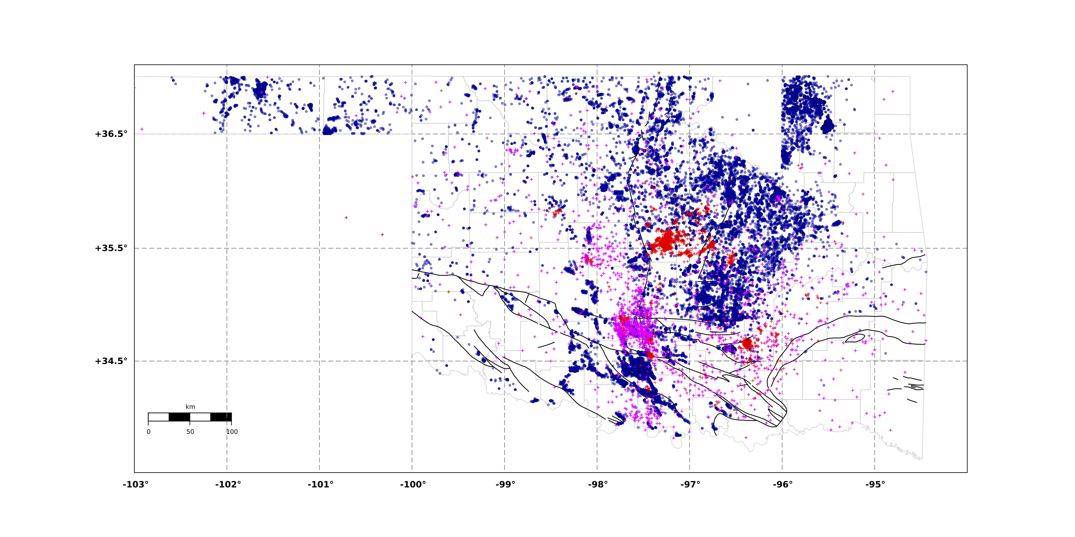
UIC Wells and Earthquakes
More than 7,500 active UIC Class II Wells in Oklahoma
Often spatially clustered

Slide 14
Increase in Earthquakes Not Matched by Increase in Fluid Injection
Oklahoma Earthquakes

Slide 15
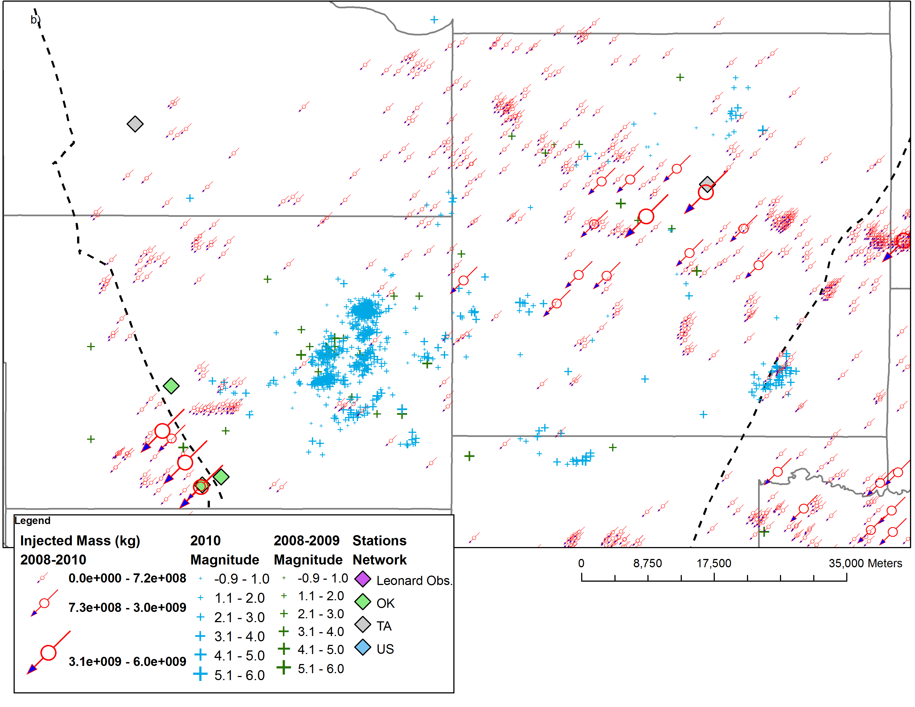
Fluid Injection in Central, OK
Lincoln
Logan
Oklahoma
Pottawatomie

Slide 16
Induced Seismicity from Hydraulic Fracturing
Recent Cases from Oklahoma
Eola Field, Garvin County, ~100 earthquakes, M_{max}=2.9
Possible, Union City Field, Canadian County, ~10 earthquakes, M_{max}=3.4
Examining other possible cases
Other recent cases
Blackpool, United Kingdom, >50 earthquakes, M_{max}=2.3
Horn River Basin, British Columbia, >40 earthquakes, M_{max}=3.5

Slide 17
Eola Field, Garvin County
Holland (2012) in review

Slide 18
Holland (2012) in review

Slide 19
psi>6000
Holland (2012) in review

Slide 20
Union City Field, Canadian County
Straight Arrow Well
16 stage frac
Completed 3/12 1:00 UTC
First earthquake 3/11 07:41
M3.4 at 23:57
Total 10 earthquakes M2.1-3.4 on 3/11
Visually identify similar examples
Notes:
The Straight Arrow well has a completion date in the OCC database of 2010-03-25.

Slide 21
Induced Seismicity from Hydraulic Fracturing
Garvin Co.
Courtesy of Jim Rutledge
Notes:
Bowland upper point is April stimulations stages 1 and 2, from
Bowland lower point is one month later, stages 4 and 5
OK point from Austin Holland’s updated magnitudes, volumes for stages 1 and 2.
Basel upper point is for 28 biggest events including three M3 within month of stimulation
Basel lower point is for pumping and immediate period afterwards.

Slide 22
Maximum Magnitude
Earthquake magnitude is related to rupture area and the average slip over that area
Earthquake rupture dynamics
Big earthquakes start small
M_{max} controlled by
fault size and properties
stress on the fault
initial rupture energy
t₃
t₂
t₁
Large faults represent large potential hazards
knowing whether or not they are favorably oriented for slip is important
but to be cautious maybe greater set-backs are warranted

Slide 23
Concerns of Induced Seismicity in the Mississippian Play
Significant amount of hydraulic fracturing
Large amounts of produced water to dispose of within the Arbuckle
Arbuckle is near the basement where faults may be stressed to near failure
Fractures and faults in basement may be poorly if identified at all

Slide 24
Avoiding Potentially Active Faults
154 earthquake focal mechanisms
Define the distribution of orientations for active faults in Oklahoma
This information can be used to modify operations to avoid faults
oriented in a way that is more likely to have triggered earthquakes
or are large, which may not be completely favorable to slip, but pose a greater hazard
T-axis
P-axis
Optimal Fault Orientations in Oklahoma
(in review Seismol. Res. Lett.)

Slide 25
Calculate a Probability Density Function (PDF) from fault orientations
PDF for all earthquakes
Outside Jones Swarm
Example focal mechanisms
Prague M5.7 EQ Sequence

Slide 26
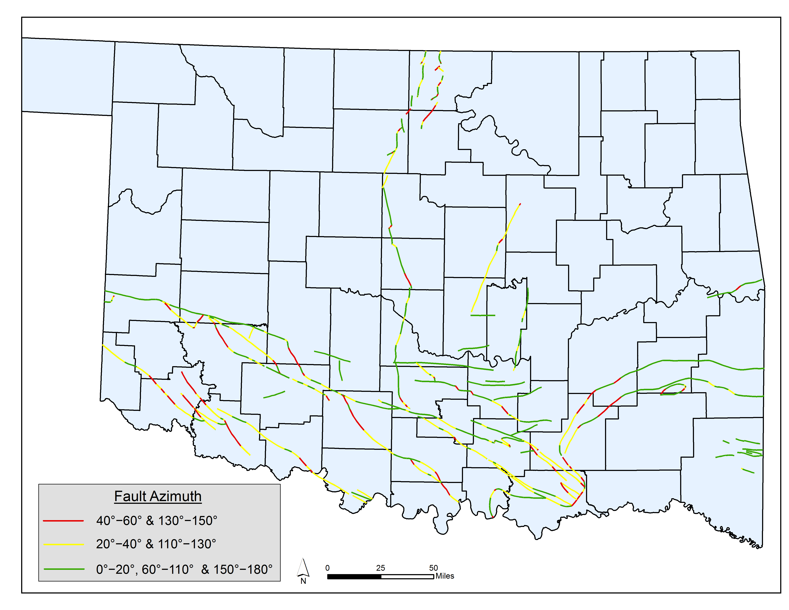
Characterizing Fault Rupture Likelihood

Slide 27
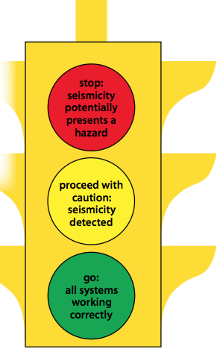
Risk Mitigation Strategies
Avoid injection into active or potentially active faults
Minimize and monitor pore pressure changes at depth
Install local seismic monitoring arrays
Establish modification protocols in advance
Be prepared to alter plans or abandon wells
Zoback (2012) Earth AGI

Slide 28
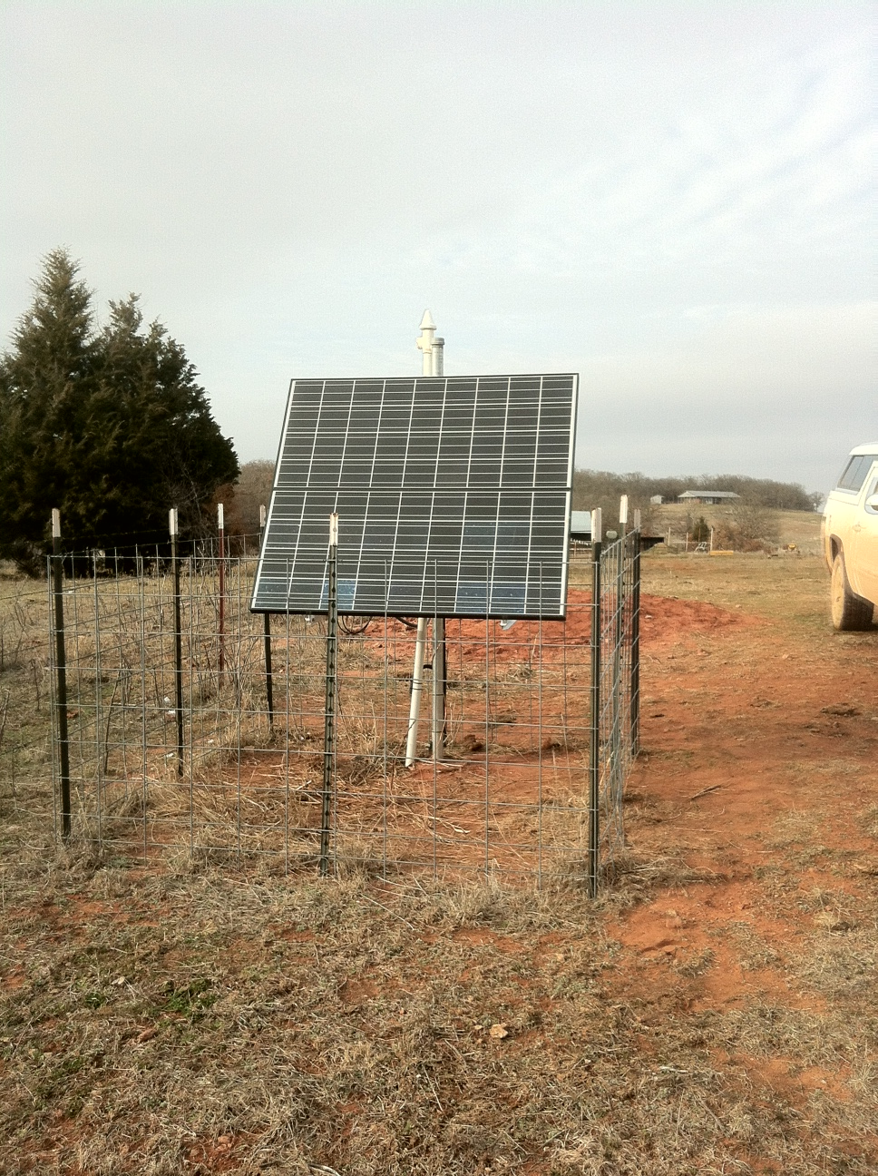
OGS Seismic Station Sponsorship
Provides a way to transparently address the possibility of induced seismicity
Removes duplication between operators
Can be tailored to meet individual operators requirements
Rapid reporting for operational feedback for participants
Cost effective
Improves products like
optimal fault orientations
Earthquake locations
Equipment donations are tax deductible

